Slide 1










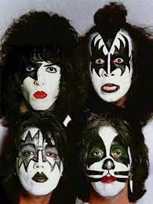





Spotify Music
Segmentation Analysis
Start Presentation
RevoU FSDA Final Project • Group E • APRIL 2023

Slide 2







Group E
Shanghai
About Spotify
Spotify is a leading audio streaming platform that connects millions of listeners and creators around the world. Founded in 2006 in Sweden, Spotify offers access to over 70 million tracks and podcasts from various genres and languages. Spotify's mission is to unlock the potential of human creativity by giving a voice to artists and enabling everyone to enjoy and be inspired by music and stories.
About us
Group Members
Overview Topics
Topic # 1
489 Million
205 Million
€3.1
Million
21%
Research
Topic # 2
Monthly Active User
Premium Active User
Total Revenue
Shares comes from USA + Canada
Conclusions

Slide 3






Group E
Shanghai
Group Members
About us
Group Members
Overview Topics
Topic # 1
Rai F
Project Manager
Aminuddin
Data Analyst team
Fikri
Visualization & Presentation Team
Nhane
Visualization & Presentation Team
Research
Topic # 2
Conclusions

Slide 4




Group E
Shanghai
Overview Topics
About us
Group Members
Overview Topics
Topic # 1
Topic #1
Data Cleaning & EDA
Topic #2
Segmentation Analysis
Topic #3
Insight & Recommendation
Name
Role
Research
Go
Topic # 2
Go
Go
Go
Conclusions

Slide 5




Group E
Shanghai
Project Objective
Overview Topics
The music industry is highly competitive, and record labels are always looking for ways to promote their artists and increase their revenue. One of the challenges faced by record labels is to understand the music listening behavior of consumers on platforms like Spotify. This is an analysis of daily music on Spotify in order to provide better recommendations to music labels in order for them to gain more listeners and become more popular.
About us
Group Members
Objective
Topic # 1
Name
Role
Research
Topic # 2
Conclusions

Slide 6


Group E
Shanghai
Methodology
The Spotify daily chart dataset was gathered from the website Kaggle
About us
Clean dataset using Python to change the datatype, handling null values, remove irrelevant values, and duplicates
Group Members
Utilising EDA to extract demographic, pattern, and insight from data
Overview Topics
Provide recommendation from data analysis
Topic # 1
Research
Data Source: Spotify HUGE database - daily charts over 3 years | Kaggle
“Database to Calculate Popularity” includes all the daily entries (8mln+) for the songs which made it to the top 200.
“Final Database” includes many data for each song. It aggregates the popularity for songs into a single score for each.
Topic # 2
Conclusions

Slide 7
Group E
Shanghai
Dataset Overview
About us
49941
159
62420 + 65499
Group Members
Overview Topics
Total row from “Database to Calculate Popularity” + “Final Database” table.
*join table are from this table using inner join and filter the data into indonesian popularity only
Total Song from all datasets.
Total column from all datasets.
Topic # 1
3069
1402
2056
Ed Sheeran
Research
Topic # 2
total song in Indonesia Popularity Dataset
Total artist in Indonesia Chart List
Total Albums in Indonesia Chart List
Most Popular in Indonesia
Conclusions

Slide 8
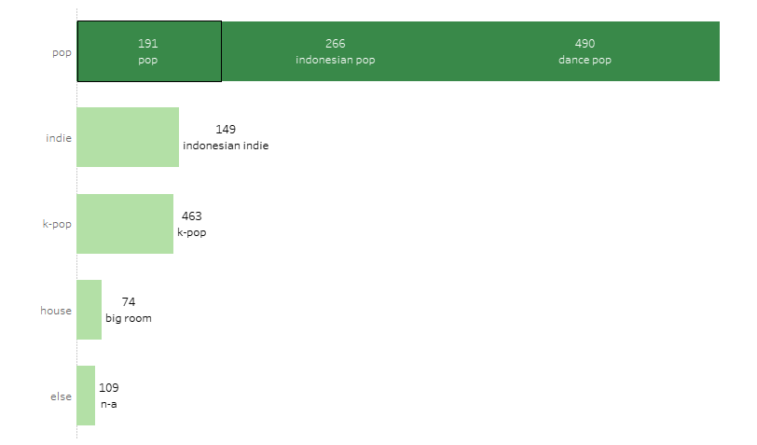

Group E
Shanghai
Popular Genre
About us
Group Members
POP GENRE IS THE MOST POPULAR GENRE, THIS INCLUDING SUB GENRE DANCE POP AND INDONESIAN POP
Overview Topics
Topic # 1
Research
Topic # 2
Conclusions

Slide 9

Group E
Shanghai
EDA - 5 MAIN POINT MUSIC CHARACTERISTICS TO ANALYZE
About us
Energy
Group Members
Overview Topics
Valence
Acousticness
Topic # 1
Research
Speechness
liveness
Topic # 2
Conclusions
*based on Spotify algorithm music detection

Slide 10
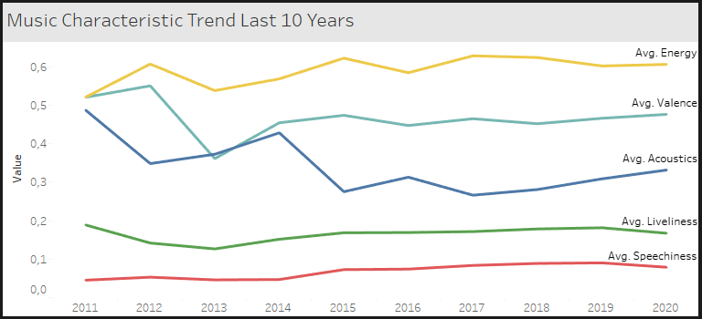
Group E
Shanghai
LET US SEE HOW’S THE MUSIC CHANGES LAST 10 YEARS BASED ON POPULARITY TRENDS
About us
Group Members
Overview Topics
Topic # 1
Research
Topic # 2
Conclusions

Slide 11
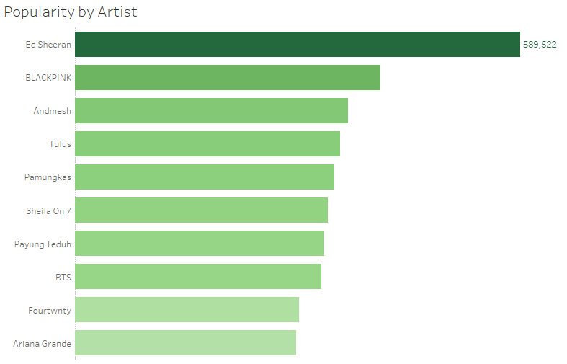
Group E
Shanghai
TOP 10 MOST POPULAR ARTIST IN INDONESIA
About us
Group Members
Overview Topics
Topic # 1
Research
Topic # 2
Conclusions

Slide 12
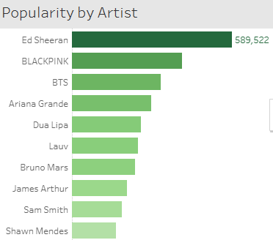
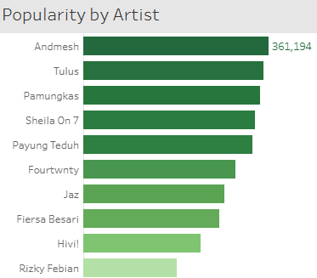
Group E
Shanghai
FOREIGN ARTIST VS INDONESIAN ARTIST
About us
Group Members
Overview Topics
Topic # 1
Research
Topic # 2
*FILTERED INDONESIAN ARTIST ONLY
Conclusions

Slide 13


Group E
Shanghai
Segmentation Analysis
By utilizing K-Means clustering method, we can perform segmentation based on their unique music characteristics. This process will enable us to group the songs into distinct clusters, allowing us to gain insights on the preferences and behaviour of different types of listeners.
With this information, music labels, producers, and artists can optimize their music by tailoring it to the specific needs and preferences of each cluster, which can lead to an increase in popularity and a higher number of listeners.
About us
Group Members
Overview Topics
Topic # 1
Research
Topic # 2
Conclusions

Slide 14
Group E
Shanghai
Data Clustering Process (with Python)
About us
5
SILHOUETTE METHOD
Group Members
CHECKING DATA DISTRIBUTION
1
4
ELBOW METHOD
Overview Topics
Topic # 1
IMPORTING LIBRARIES
2
3
DATA SCALE
Research
Songs that belong to the same cluster based on musical features such as valence, acousticness, and energy, are more likely to be popular among listeners who prefer that particular style of music
- Hypothesis -
Topic # 2
Conclusions

Slide 15
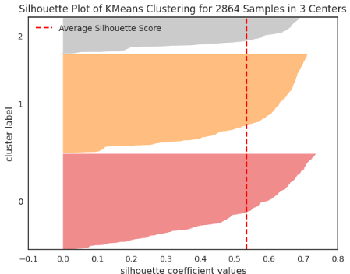
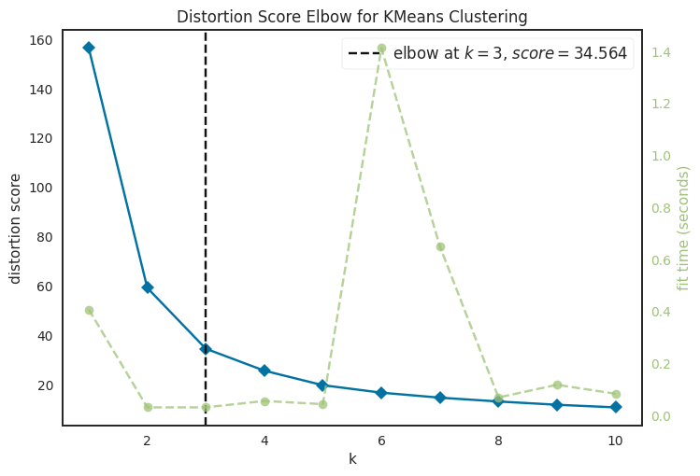
Group E
Shanghai
Preparation for Clustering Analysis using python
About us
Group Members
Overview Topics
Topic # 1
Research
Elbow Method
Silhouette Methood
Topic # 2
Determining the number of cluster by using 2 method
based on the two method now we set the cluster into 3 section
Conclusions

Slide 16

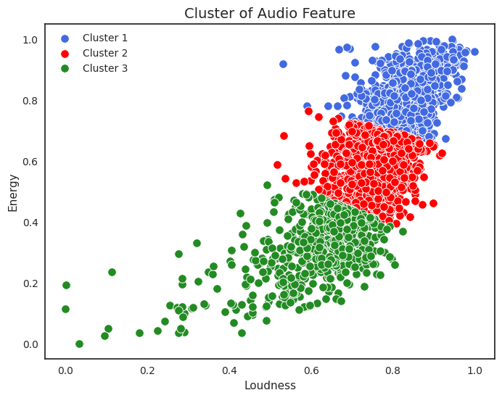
Group E
Shanghai
CLUSTERING MODEL
About us
Group Members
Overview Topics
Topic # 1
Research
Topic # 2
Cluster model data with k = 3
Conclusions
Link to Collab

Slide 17
Group E
Shanghai
CLUSTERING MODEL
Cluster 1 | Cluster 2 | Cluster 3
Popularity
Low Popularity, Moderate Followers | High Popularity, Highest Followers | Highest Popularity, Low Followers
Music Attributes
High value on danceability, energy, loudness, speechiness, liveliness, valence & tempo | Moderate value on danceability, energy, loudness, speechiness, liveliness, valence & tempo. Also on Accousticness & Instrumentalness | Low value on danceability, energy, loudness, speechiness, liveliness, valence & tempo, Highest on Accousticness & Instrumentalness
About us
Group Members
Overview Topics
Topic # 1
Research
Cluster 1 has the lowest Popularity, but Artist_followers is quite large compared to cluster 3. This cluster tends to produce songs with danceable and energetic beats, as well as positive and cheerful nuances.
Cluster 2 has a fairly high popularity with the largest Artist_followers among other clusters. Has quite high popularity and produces songs with minimal acoustic and instrument nuances, but still danceable and positive nuances.
Cluster 3 has the highest Popularity and the lowest Artist_followers compared to the other clusters. This cluster only focus on acoustic and instrumental nuances.
Topic # 2
Conclusions

Slide 18

Group E
Shanghai
Number 1 Popular Vs Number 101 in Indonesian Chart
About us
Group Members
Overview Topics
Topic # 1
Top #1
Ed Sheeran
Top #101
Samsons
Research
Topic # 2
comparing 2 Artist from different clusters and based on number of popularity in Indonesia
Conclusions

Slide 19
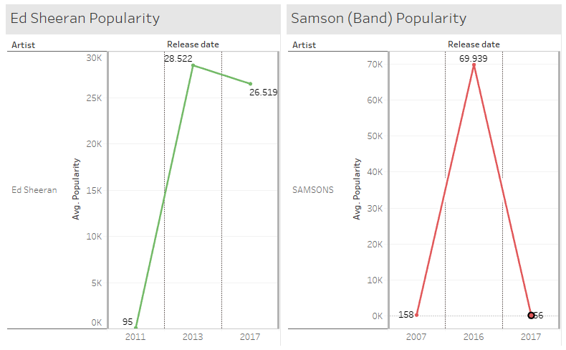
Group E
Shanghai
Number 1 Popular Vs Number 101 in Indonesian Chart
About us
Ed Sheeran
Group Members
Overview Topics
Samsons Band
Topic # 1
Research
In 2011 Ed Sheeran released an song and the popularity score is above 28 Thousand and in 2017 stay relatively still
In some case Samson’s song in 2016 is more popular than Ed Sheeran song with almost 70 Thousand score but then decreasing to only 56 making it not so popular anymore
Topic # 2
Conclusions

Slide 20
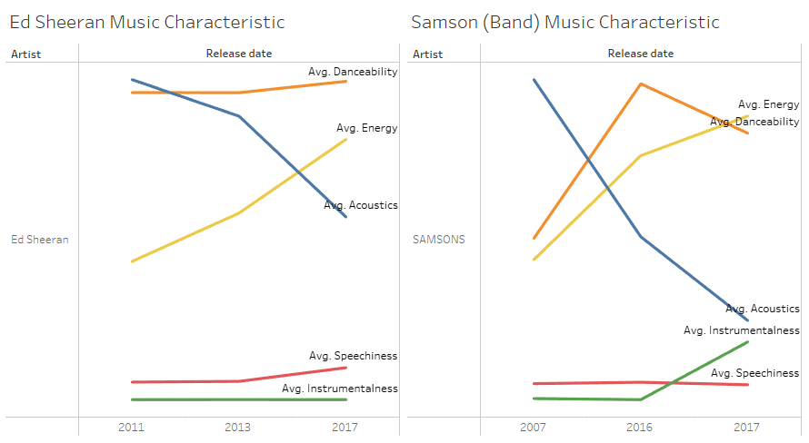
Group E
Shanghai
Number 1 Popular Vs Number 101 in Indonesian Chart
About us
Ed Sheeran
Group Members
Overview Topics
Samsons Band
Topic # 1
Research
Most Ed sheeran popular music have the characteristic of high acousticness song and high danceablity. But not so energetic
Samson’s song in the other hand having the Avg. Danceabilty characteristic are higher and acousticness level are low.
IT SHOWS THESE 2 MUSIC TYPE ARE DIFFERENT FROM EACH OTHER
Topic # 2
Conclusions

Slide 21

Group E
Shanghai
About us
WE WANTED TO GIVE INSIGHT AND RECOMMENDATION TO PEOPLE WHO WANTED TO JOIN INDONESIAN MUSIC INDUSTRY
Group Members
Overview Topics
Topic # 1
Research
Topic # 2
Conclusions

Slide 22

Group E
Shanghai
RECOMMENDATION
About us
to Artist, Band, Musician who wanted to play role in Indonesian music industry
Group Members
Overview Topics
Based on the analysis in the previous slide, we can provide Insight and recommendation to artist to gain more popularity:
Local Music Still very much appreciated in Indonesia,
Creating songs that have high danceability, energy, loudness, speechiness, liveliness, and valence without losing acoustic and instrumental values.
Topic # 1
Research
Topic # 2
Conclusions
Notes:
Some possible recommendations for Music Labels are:
- For Cluster 1: The Energetic Dreamers. Although this cluster has a large number of artist followers, the popularity of the songs is low, promote the artists more on social media and streaming platforms to increase their popularity and exposure. Also, collaborate with artists from other clusters to create more diverse and appealing songs.
- For Cluster 2: The Pop Sensations, maintain the quality and consistency of the songs and artists, as they already have a large and loyal fan base. Also, experiment with different genres and styles to attract new listeners and expand their market susch as collaborations with popular DJs and remix artists.
- For Cluster 3: The Acoustic Virtuosos, invest more in marketing and advertising to boost their popularity and visibility. To attract more followers, the label could consider promoting the songs through live performances and tours. Also, incorporate more danceable and energetic elements to their songs to make them more catchy and engaging.

Slide 23
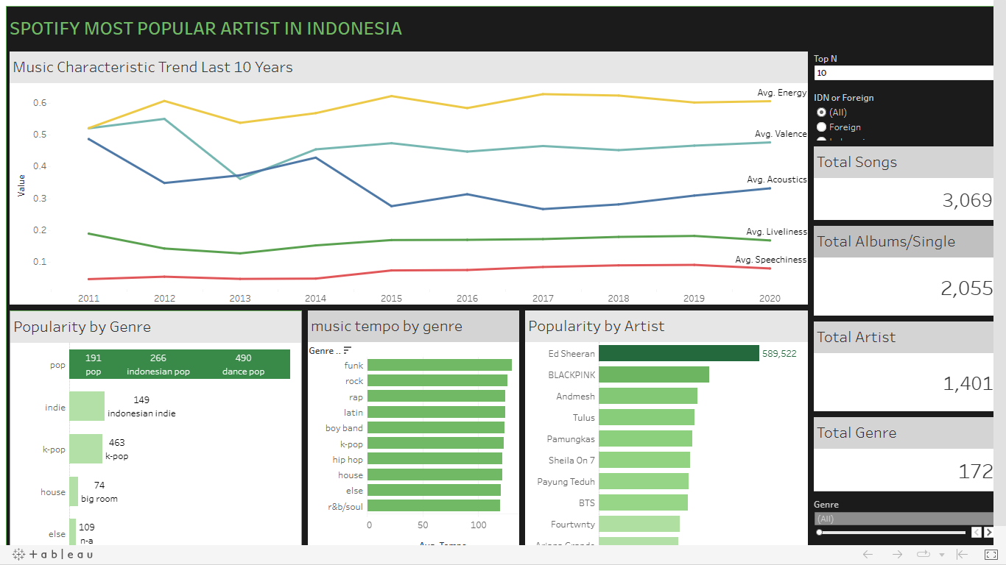
Group E
Shanghai
THE TABLEAU DASHBOARD
About us
Group Members
Overview Topics
Topic # 1
Research
Topic # 2
Link to Dashboard
Conclusions

Slide 24
Group E - Shanghai
Thanks
Revou Group Final Project

Slide 25
Group E
Shanghai
LINK TO PROJECT
Google Collab
https://colab.research.google.com/drive/1YEBXj4OPSIFRmhYNDDVxPPMdijJb8yL5?usp=share_link
Tableu Public
https://public.tableau.com/views/TeamE_SpotifyDataset_RevoUPitchingDay/Dashboard1?:language=en-US&:display_count=n&:origin=viz_share_link
About us
Group Members
FURTHER REFERENCE
Overview Topics
Spotify Share Holder Deck 2022 Q4
Spotify - Investor Relations
Topic # 1
Research
Topic # 2
Conclusions

